Slide 1
Introduction to Survival Analysis
Part #3
Dr Oliver Perra
Full resource, see: https://www.ncrm.ac.uk/resources/online/all/?id=20850

Slide 2
So far…
Survival Analysis: statistical method to answer questions concerning whether and when an event takes place
  Life Tables summarise event occurrence over time
  Hazard function: conditional probability of individual experiencing the event in the interval, given they did not experience it before
  Survivor function: probability of surviving past a time interval for a randomly selected individual

Slide 3
Outline
Explore differences in time event occurrence associated with covariates / predictors
Modelling covariates effects
The logit of hazard function
Notes:
In this presentation I will first illustrate how we can explore differences in event occurrence between different values of covariates or predictors.
I will then discuss issues and assumptions that allow to start building models to represent the effects of covariates, and I will introduce the logit hazard function, which is the basic block for building more sophisticated models in survival analysis.
I highlight again that I will only present examples applied discrete time events, events that are measured in coarse time units like years, because I believe these examples provide a strong foundation for understanding more sophisticated survival analysis methods like Cox regression models.

Slide 4
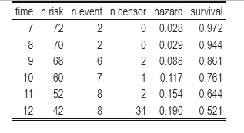
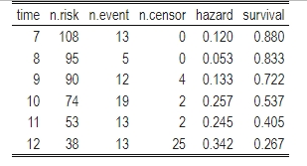
Include covariates
pt <- Parental Transitions (0 = never; 1 = ever):
No parental transitions: n=72 (40%)
Parental transitions: n=108 (60%)
Notes:
I am going to use the same dataset from the previous presentation: a modified version of the Capaldi et al’s study of sexual intercourse initiation in adolescent males. The time metric here was grade years, from grade 7 to grade 12.
One covariate in the study was parental transitions before grade 7: adolescents reported if they had experienced one or more changes in parental figures before grade 7, or not. The variable is a proxy for lack of stability in parental relationships.
Here I show the life tables for the two groups, the 72 adolescents who had not experienced parental transitions before grade 7, and the 108 that did experience these.
In the online material you can find R scripts to create these tables and the rest of the outputs I will show in this presentation.
A quick look at the tables tells us that the risk of the event seems higher in the second group and, conversely, the probability of surviving is lower in this group.

Slide 5
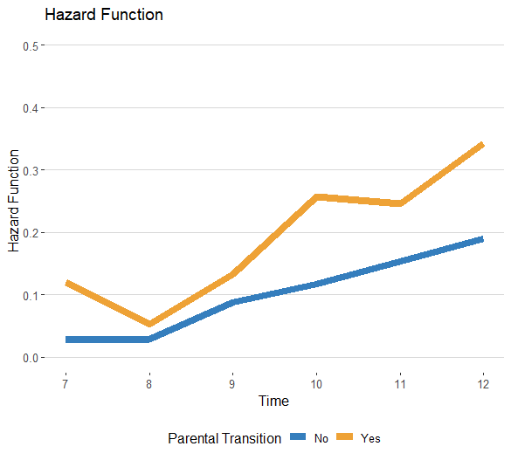
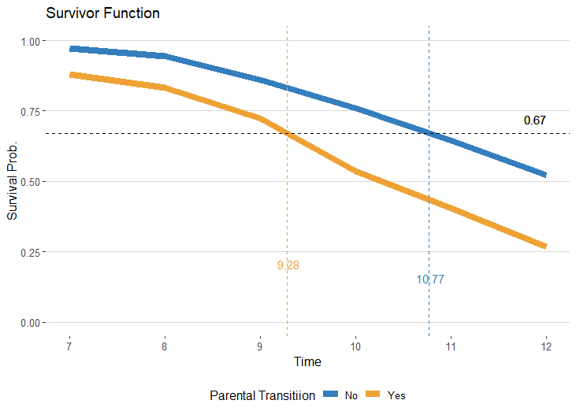
Include covariates
pt <- Parental Transitions (0 = never; 1 = ever):
Notes:
Here I show the hazard function and survivor functions for the two groups.
When we are considering the hazard function, there are two issues to consider:
The first is the shape of the hazard functions for different groups: we can check if these functions peak at the same time, or show different patterns. Here, despite some differences, the shapes of the two curves appear generally similar.
The second consideration should focus on the relative level of the two curves: do they indicate that one group is consistently at higher risk of the event? Furthermore, does the magnitude of this difference vary over time? Here the curves indicate that adolescent males who had been exposed to parental transitions consistently showed a higher risk of initiating sexual intercourse across grades 7 to 12. But does this difference vary over time? Although it may appear that the differences in risk are higher in later years, overall the variation in the level of hazard between groups across time does not seem considerable.
Remember that the hazard function tells us about risk of the event taking place within specific time periods. The survivor function tells us about cumulative effects over time: for this reason, when we compare survivor functions of different groups we get an idea about the cumulative effect of a predictor over time. Note also how the order of two curves is reversed: since those with parental transitions are more at risk when we consider the hazard function, they are less likely to “survive”, that is less likely to avoid the target event, when you look at the survivor function.
In this case we can see that the cumulative effect of parental transition is quite pronounced. By grade 12, approximately half of the adolescents with no parental transitions have had sexual intercourse, whereas three quarters of those who had been exposed to parental transitions have had sexual intercourse.
Note that since the survivor function of the group with no parental transition does not reach the mid-point where 50% have a probability to have experienced the event, it is not possible to calculate the exact median lifetime for this group, therefore here I calculated the first tertile lifetime, i.e. the point where one third of the participants have experienced the event in the two groups. The differences in these summary statistics highlight the group differences: a third of adolescents who had parental transitions initiate intercourse more than a year before a third of those who had not parental transitions did.

Slide 6
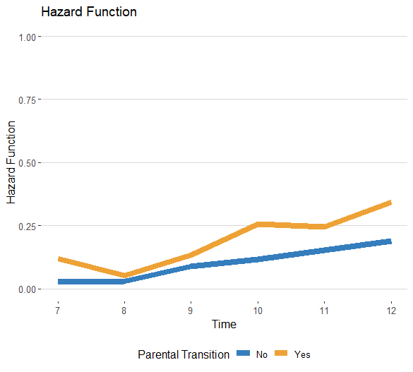
Modelling
Issues:
1. Models should describe shape of functions over time
2. Bounded nature of probability values
Notes:
Inspections of the life tables and graphs of the hazard and survivor functions are very useful in getting some insights into between-group differences in whether and when an event takes place.
Incidentally, if we wanted to get some intuition about differences in risk associated with continuous variable, we could categorise the continuous variable in some meaningful ways and calculate the hazard and survivor functions for all or salient sub-groups created. For example, we could compare the hazard functions of participants that scored 1 SD below and those that scored 1 SD above the continuous variable.
Now, we need to move from these intuitions to more formal models. The hazard function is the main estimate of interest here, since it represents the risk of event occurrence within time-periods.
To model this outcome, we need to consider a model that describes the shape of the whole hazard function over time. This task is complicated by the bounded nature of this estimate: since the hazard function is a conditional probability, its values should lie within 0 and 1.
To deal with this issue, Cox recommended transforming these probability in odds and log odds.

Slide 7
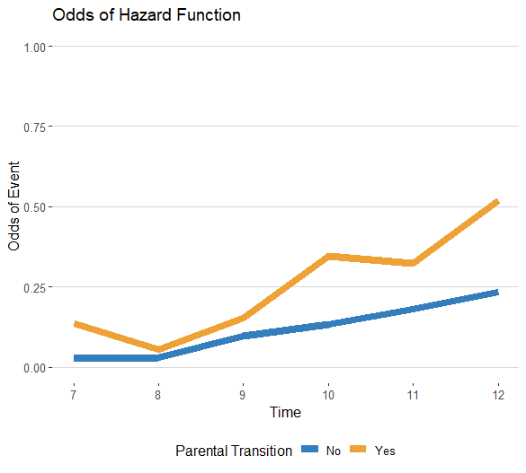
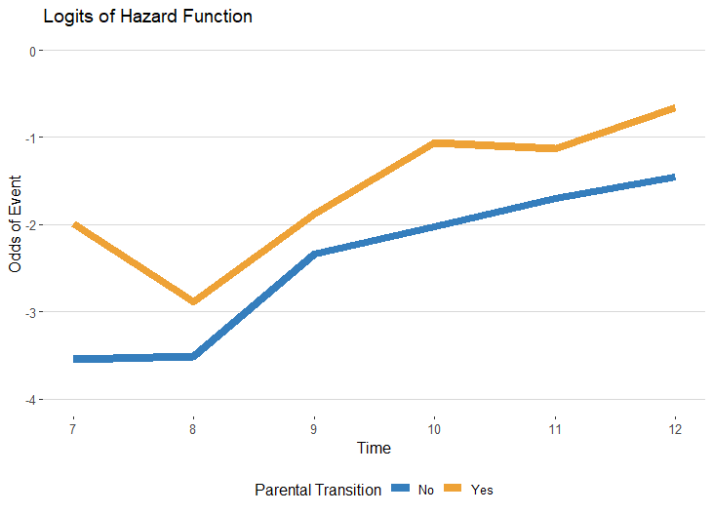
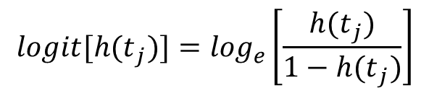
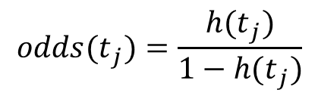
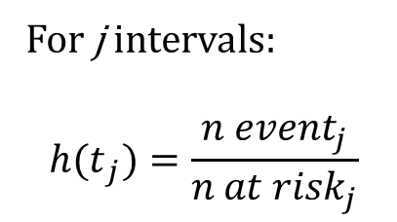
Transforming the Hazard Function
For j intervals:
$${h(t}_{j})=\frac{{n event}_{j}}{{n at risk}_{j}}$$
$${odds(t}_{j})=\frac{{h(t}_{j})}{1−{h(t}_{j})}$$
$${logit[h(t}_{j})]=\log_{e}\left[\frac{{h(t}_{j})}{1−{h(t}_{j})}\right]$$
Notes:
Here I illustrate the transformation applied to the hazard functions. The logit is the natural logarithm of the odds. If you have run logistic regressions, you may already be familiar with the key characteristics of logits.
The key advantage of using logits is that these values are not bounded : the logit of the mid=point in a probability distribution, that is the logit of .5 is 0.
So logit values below 0 correspond to probabilities <.50, while the logit of 0 is an infinitesimally small value. Logit values above 0 correspond to probability values above .5, while, the logit of 1 is an infinitesimally large value.
The logit transformation is also useful in turning skewed distributions into more symmetrical ones.
One way to better understand how the logit transformation works is to remember that these are particularly useful in representing differences in magnitude of values.
If we look at the logit transformation in the bottom, we can see that the distance between the two functions in the first years are larger in the logit scale when the hazard values are small in both cases, but the differences are smaller in the final years, when the hazard values are larger.
These changes should highlight another key advantage of the logit transformation: the distance between the two functions over time it’s easier to compare: the logits make the difference between functions more stable. This facilitates modelling.

Slide 8
Modelling Logits of Hazard Functions
Initial assumptions in model building:
There is a logit hazard function for each value of the predictor
Each of the logit hazard functions has the same shape
The distance between each logit hazard value is the same in each time interval
Notes:
Now, since we have a better metric for our outcome of interest, the logits of the hazard function, we can think about what model can describe these functions more adequately. We could, for example, hypothesise a linear model, which here I represented using dashed lines. We could think of curvilinear models, for example a quadratic model.
Whichever model we choose, the task of staring modelling is facilitated if we follow set of assumptions:
There is an estimated logit hazard function for each value of the predictor. In this case, we will estimate two hazard functions. When we work with continuous predictors, we estimate hazard functions for each value of the continuous predictor.
The task is also facilitated greatly if we assume that the functions for different levels of predictors have the same shape. For example, here we are assuming both functions follow a linear trend.
Finally, we assume that the distance between logits of the two functions is the same in each time interval. For example, here we see that the two hypothesised linear trends are parallel, the distance between the two values is the same at each time point.
The advantage of these assumptions in model building should be evident: for example, if we assume the shapes of the hazard functions are the same, our models are simpler and more straightforward. But as all assumptions, these may be untenable and ill-advised in some cases. If you delve into Survival Analysis beyond this introductory presentation you will learn ways to test these assumptions and relax them when they are clearly inadequate.

Slide 9
Modelling Logits of Hazard Functions: General Specification
Specify a baseline function for individuals with Covs = 0
Considering the baseline group, specify intercepts for the logit hazard in each time interval
Notes:
In the example I am using here a linear model may appear relatively appropriate. But in many cases logits of hazards display trends that are difficult to reconcile to common models like a linear or quadratic one.
For this reason, we may start analyses by specifying a general model that has no constraints on the shape of the logit hazard function, although a general, unconstrained model is not parsimonious: it has a cost.
How can we build a general specification model?
The idea is to firstly specify a “baseline” function. This is the logit hazard function when the values of predictors are equal to 0. In this case, the baseline function corresponds to the logit hazard of adolescents with no parental transitions.
A general, unconstrained curve for the baseline model can then be specified by assuming there are different intercepts that represent the expected value of the logit hazard in every time interval, for those in the baseline group.
How does this work in practice? To better understand it, it is important to consider how the data should be organised.

Slide 10
The Person-Period dataset
Person-Level dataset
Person-Period dataset
ID | Time | Event | Censor
1 | 9 | 1 | 0
2 | 12 | 0 | 1
17 | 7 | 1 | 0
…
ID | Period | Event
1 | 7 | 0
1 | 8 | 0
1 | 9 | 1
2 | 7 | 0
2 | 8 | 0
2 | 9 | 0
2 | 10 | 0
2 | 11 | 0
2 | 12 | 0
17 | 7 | 1
…
Notes:
If you have experience with multilevel models, this is very similar to the transformation from a “wide” dataset, where every row corresponds to a participant, to a “long” dataset, where every row corresponds to a participants’ measurement occasions: measurement occasions are nested within participants.
The idea is that every participant contributes different “periods” to the dataset, different time intervals. Participant #1 contributes only 3 periods, that is, there are observations of this participant up until the point when he reported the event, initiation of intercourse. Participant #2 contributes 6 periods, up until the point the study stopped. No event was ever recorded during these periods. Participant #17 only contributed one period, since he experienced the event within this initial period.

Slide 11
Time Periods Indices and Intercepts
Person-Period dataset
ID | Period | Event | P7 | P8 | P9 | P10 | P11 | P12 | α7 | α8 | … | α12
1 | 7 | 0 | 1 | 0 | 0 | 0 | 0 | 0 | -2.40 | -3.12 |  | -1.23
1 | 8 | 0 | 0 | 1 | 0 | 0 | 0 | 0 | -2.40 | -3.12 |  | -1.23
1 | 9 | 1 | 0 | 0 | 1 | 0 | 0 | 0 | -2.40 | -3.12 |  | -1.23
2 | 7 | 0 | 1 | 0 | 0 | 0 | 0 | 0 | -2.40 | -3.12 |  | -1.23
2 | 8 | 0 | 0 | 1 | 0 | 0 | 0 | 0 | -2.40 | -3.12 |  | -1.23
2 | 9 | 0 | 0 | 0 | 1 | 0 | 0 | 0 | -2.40 | -3.12 |  | -1.23
2 | 10 | 0 | 0 | 0 | 0 | 1 | 0 | 0 | -2.40 | -3.12 |  | -1.23
2 | 11 | 0 | 0 | 0 | 0 | 0 | 1 | 0 | -2.40 | -3.12 |  | -1.23
2 | 12 | 0 | 0 | 0 | 0 | 0 | 0 | 1 | -2.40 | -3.12 |  | -1.23
17 | 7 | 1 | 1 | 0 | 0 | 0 | 0 | 0 | -2.40 | -3.12 |  | -1.23
…
Notes:
Once we have structured the dataset in this way, we can create a set of dummies for each time period: these dummies are set to 1 in the time period they represent, and 0 in all the other periods.
In this way, once we estimate intercepts alpha for each time period, these are only “switched on” during that time period: by multiplying the dummy time period index with the alpha intercept, the intercept is only relevant in its specific time period
I tried to represent here that when we are considering period 7, for example, the only parameter alpha that remain when we multiplicate the dummies by the alphas, is alpha 7, -2.40.

Slide 12
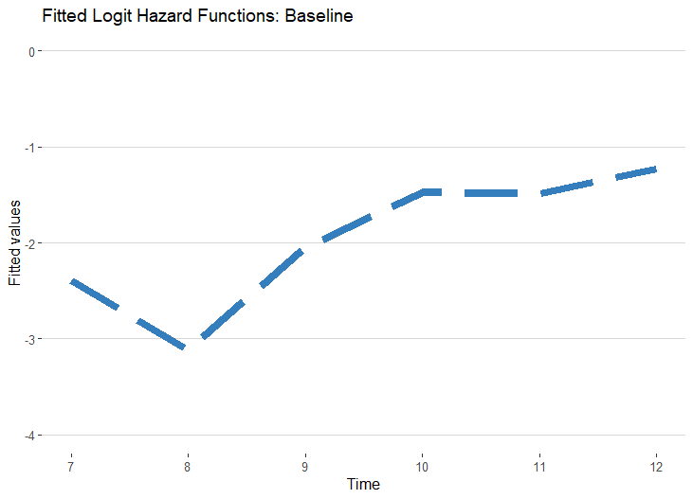
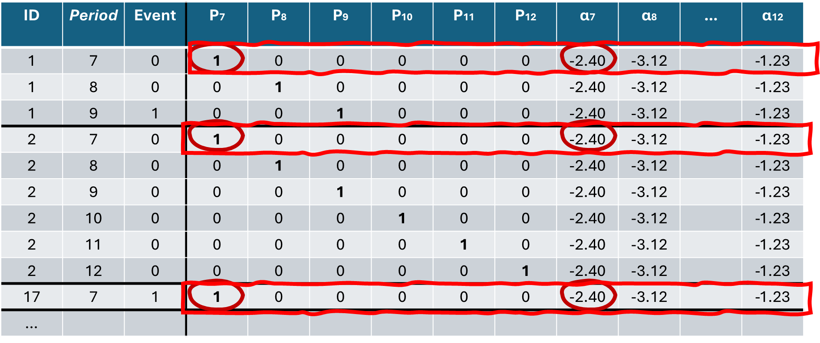
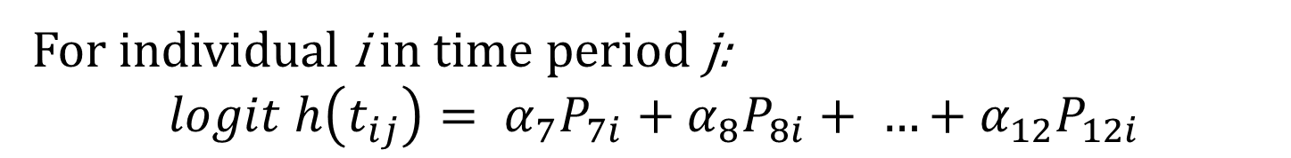
Modelling Logits of Hazard Functions: Baseline
Person-Period dataset
-1.23
-2.40
-3.12
For individual i in time period j:
$$logit h\left(t_{ij}\right)= α_{7}P_{7i}+α_{8}P_{8i}+ …+α_{12}P_{12i}$$
E.g., when j = 7:
$logit h\left(t_{8}\right)= −2.40\left(1\right)+\left[−3.12 \left(0\right)\right]+ …+[−1.23 \left(0\right)] = −2.40$
Notes:
In this way we can specify a line that does not follow a pre-set shape, such as linear or quadratic, but can be jagged and irregular and thus be closer to the data observed.
Here I also put a formal definition of the baseline model, where I specified that the logit of the hazard function for individual i in time period j are the sum of the product of dummies for each period and their relative intercept (alpha) values.
So, say, when the time period is 7, we take this equation, substitute the P indices with their value in the row corresponding to period 7, also substitute the alphas with their values in the row of period 7, we will obtain that the logit hazard for period 7 is equal to its specific intercept, -2.40.
Effectively, each time period has its own period-specific intercept, and thus we obtain a jagged line like the one displayed here.

Slide 13

The Person-Period dataset
Person-Period dataset
ID | Period | Event | PT | X
1 | 7 | 0 | 0 | 0
1 | 8 | 0 | 0 | 1
1 | 9 | 1 | 0 | 3
2 | 7 | 0 | 1 | 0
2 | 8 | 0 | 1 | 0
2 | 9 | 0 | 1 | 1
2 | 10 | 0 | 1 | 1
2 | 11 | 0 | 1 | 2
2 | 12 | 0 | 1 | 2
17 | 7 | 1 | 0 | 1
…
$$logit h\left(t_{ij}\right)=$$
$=\left( α_{7}P_{7i}+α_{8}P_{8i}+ …+α_{12}P_{12i}\right)$ $+$
$$+ \left( β_{PT}{PT}_{i}+β_{X}X_{ij} \right)$$
Notes:
Now, we also have covariates in the model. In this case, parental transition PT, was recorded before grade 7, and will not change between grade 7 and 12. It is a time invariant covariates.
But the person-period dataset makes it easy to also include time-varying covariates: here, I just created a fictional covariate X and assumed this covariate varied between 0 and 3 across time periods. A similar time varying covariate may be, for example, frequency of alcohol use in the previous year, which research suggests is a significant predictor of whether and when adolescents have intercourse for the first time.
But how do we include covariates in the estimation of logit hazards?
Here I put the formal definition of the model. The first part is the baseline model I have just described.
The second part of the equation shows that we assume slopes for each covariate.
Note that the value of the time-invariant covariate PT only changes from one individual i to another. Instead, the value of the time-varying covariate X will change across individuals i and time periods j.
The slopes represent expected changes in event occurrence associated with one unit increase in that covariate, while controlling for the effect of the other covariates in the model.
This is akin to other regression models/.
However, it is worthwhile reflecting on what this equation is doing conceptually. In survival analysis we are interested in answering questions about the relationship between the timing of an event and covariates or predictors. So, time is conceptually an outcome. However, this model is basically making time indexed in periods, a predictor. Paradoxically the outcome of interest has become the predictor. But this is possible because this formulation of the model is changing the question from “what is the association between timing of an event and predictors?” to “what is the association between the risk of event occurrence in each time period and predictors?” By answering the second question about risk of event occurrence in each period and predictors, we can ask the first question about associations of predictors with timing of events.

Slide 14
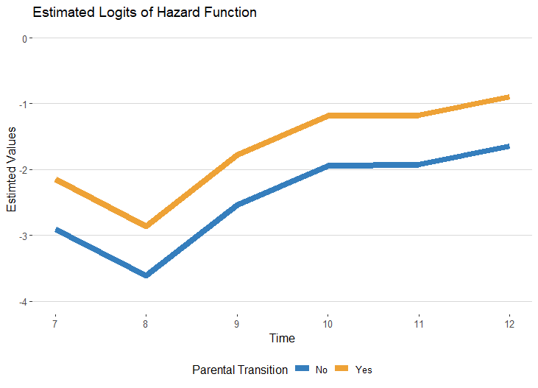



Modelling Logit Hazard Function with Covariates
$$logit h\left(t_{ij}\right)=$$
$=\left( α_{7}P_{7i}+α_{8}P_{8i}+ …+α_{12}P_{12i}\right)$ $+$
$$+ \left( β_{PT}{PT}_{i} \right)$$
$$β_{PT}$$
$$When PT=0 :$$
$logit h\left(t_{ij}\right)=$ $\left( α_{7}P_{7ij}+α_{8}P_{8ij}+ …+α_{12}P_{12ij}\right)$
$When PT=1 :$
$logit h\left(t_{ij}\right)=$ $\left( α_{7}P_{7ij}+α_{8}P_{8ij}+ …+α_{12}P_{12ij}\right)+ β_{PT}$
Notes:
Let’s just consider the covariate Parental Transition: we can see that when this variable is 0 for cases that did not experience parental transitions, we obtain the baseline function described before. But when the covariate is 1 for cases that did experience parental transitions, we are basically adding the slope of the covariate to the baseline transition in each time period.
Represented graphically, it means that the logits of the hazard function of cases that experienced parental transition will just shift in each time period by a degree that corresponds to the covariate slope. In this case, we can see that the line of those with parental transitions shifts constantly upward, representing increased risk for those who had experienced parental transitions.
This is consistent with the goals of creating models where the logit hazard functions of different covariate values have the same shape and the distance between these functions is the same across time periods.

Slide 15
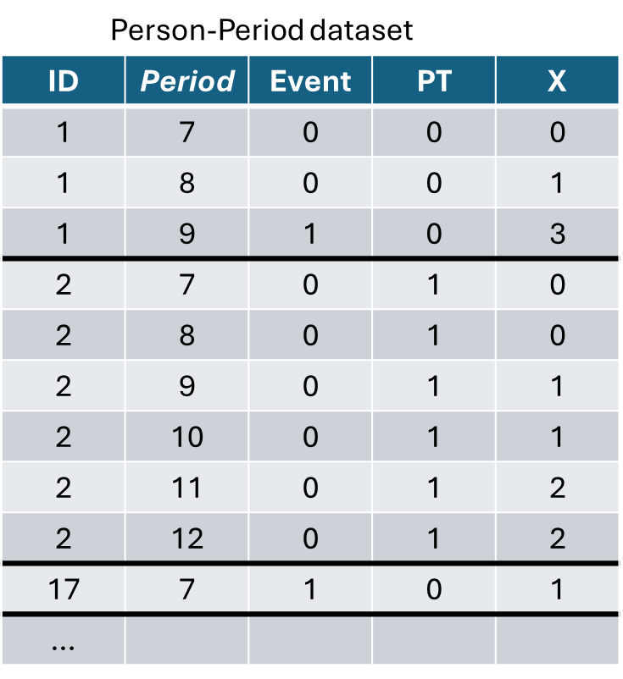
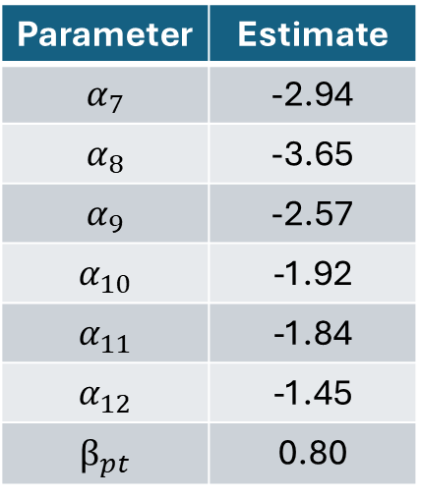
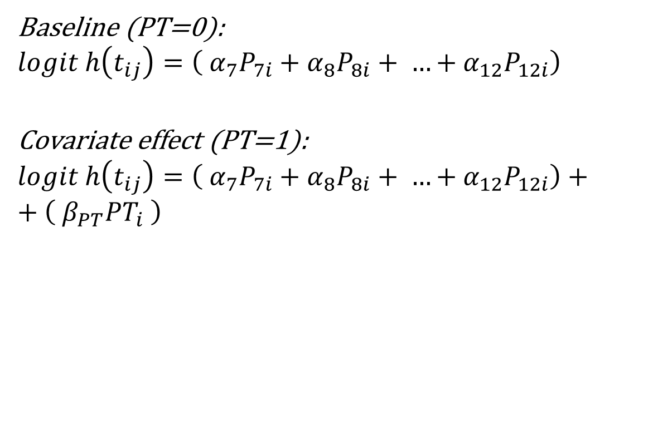
Maximum Likelihood Estimation
Baseline (PT=0):
$$logit h\left(t_{ij}\right)=\left( α_{7}P_{7i}+α_{8}P_{8i}+ …+α_{12}P_{12i}\right)$$
Covariate effect (PT=1):
$$logit h\left(t_{ij}\right)=\left( α_{7}P_{7i}+α_{8}P_{8i}+ …+α_{12}P_{12i}\right)+$$
$$+ \left( β_{PT}{PT}_{i} \right)$$
Notes:
We can estimate the parameters of a similar model using maximum likelihood methods.
Indeed, we can estimate these parameters starting from the person-period dataset, and just regress the event indicator on the time period indicators and covariates using logistic regression.
One objection to using logistic regression in this way may highlight that time periods j are nested within individuals, so they are not independent variables. However, this objection is addressed by considering that the hazard functions represent conditional probabilities of event occurrence in a specific time period, conditional on the individual not experiencing the event in previous time periods. Therefore, the records in the person-period dataset are conditionally independent.

Slide 16
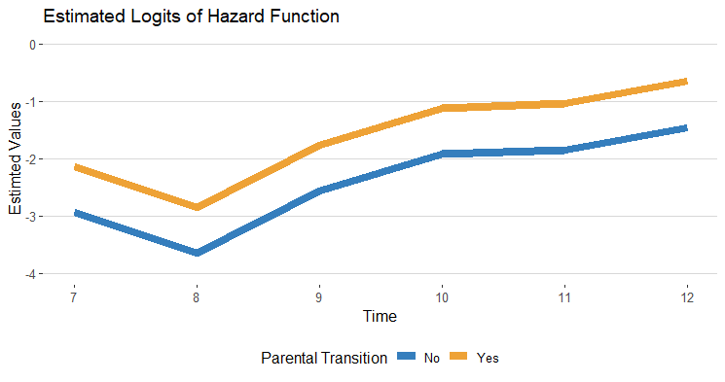
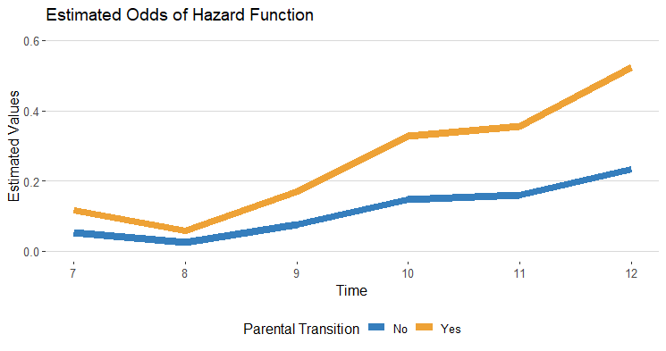
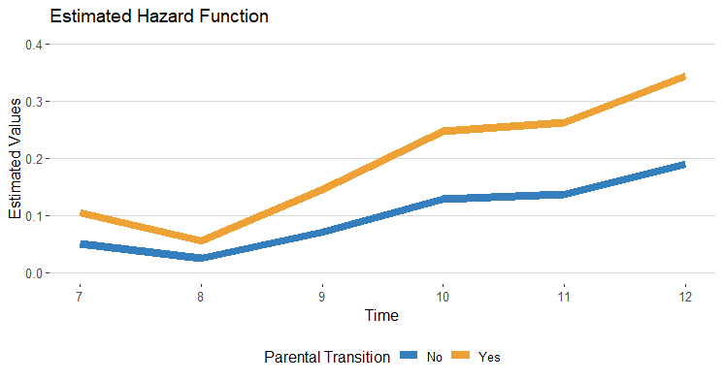



Representing the model in different scales
$$\frac{{odds}_{j=8, pt=0}}{{odds}_{j=8, pt=1}}=\frac{0.0260}{0.0582}=0.447$$
$$\frac{{odds}_{j=12, pt=0}}{{odds}_{j=12, pt=1}}=\frac{0.2338}{0.5225}=0.447$$
$${odds}_{j,pt=1}=0.447 ({odds}_{j,pt=0})$$
Notes:
The estimates of the model are represented in the top panel: the estimates are in the logit scale, and both logit functions for the baseline group with no parental transition and the other group who experienced parental transitions have the same shape across time and the distance between the two estimates is the same in every time period.
But when we transform these estimates in other scales, we see that the picture changes. When we look at the odds, the larger panel on the left, we can see the difference between values changes over time periods. However, if we take the odds of each time period and calculate their ratio for the values of the covariates, we will obtain the same number, in this example .47. In other words, the relative distance of the odds is constant, or else, the odds of the outcome for those who experienced parental transitions are proportional to the odds of the baseline group, those that did not experience a parental transition.
This characteristic of the odds model follows from constraining the logit estimates to have a constant distance. A model with a similar constraint is therefore called a proportional odds model.
I also report the hazard estimates calculated transforming the logit estimates: although the two lines appear very similar to those of the odds, the hazard estimates are not proportional, do not have the same relative distance as the odds do.

Slide 17
Representing the model in different scales
Notes:
This brings me to provide some caution in interpreting the results of survival analysis:
If we reported and observed the estimated hazard functions on the right, we may be tempted to say that there is an interaction between the covariate and time, that is, the effect of parental transition on the risk of initiating intercourse changes over time. We might be tempted to draw this conclusion by observing the increasing gap between the two groups we observe in the plot on the right.
However, this conclusion would be wrong: in fact, we need to keep in mind that the model we specified and I report here again, only included a linear effect of parental transition on the logit hazard. A linear effect on the logit scale that implies a constant effect of parental transition, will look like a time varying covariate effect on the hazard function scale, but we should not draw conclusions from observing the hazard functions plots that we derive by transforming estimates from the actual model expressed in the logit scale.

Slide 18
Representing the model in different scales
$$logit h\left(t_{ij}\right)=\left( α_{7}P_{7i}+α_{8}P_{8i}+ …+α_{12}P_{12i}\right) + \left( β_{PT}{PT}_{i} \right)$$
Notes:
This brings me to provide some caution in interpreting the results of survival analysis:
If we reported and observed the estimated hazard functions on the right, we may be tempted to say that there is an interaction between the covariate and time, that is, the effect of parental transition on the risk of initiating intercourse changes over time. We might be tempted to draw this conclusion by observing the increasing gap between the two groups we observe in the plot on the right.
However, this conclusion would be wrong: in fact, we need to keep in mind that the model we specified and I report here again, only included a linear effect of parental transition on the logit hazard. A linear effect on the logit scale that implies a constant effect of parental transition, will look like a time varying covariate effect on the hazard function scale, but we should not draw conclusions from observing the hazard functions plots that we derive by transforming estimates from the actual model expressed in the logit scale.

Slide 19
Summary
Explore differences in time event using life tables and plots
Modelling through the logit of hazard function
Maximum Likelihood estimation through logistic regression
Models have stringent assumption, which should be tested and can be relaxed.
Notes:
In this presentation I will first illustrate how we can explore differences in event occurrence between different values of covariates or predictors.
I will then discuss issues and assumptions that allow to start building models to represent the effects of covariates, and I will introduce the logit hazard function, which is the basic block for building more sophisticated models in survival analysis.
I highlight again that I will only present examples applied discrete time events, events that are measured in coarse time units like years, because I believe these examples provide a strong foundation for understanding more sophisticated survival analysis methods like Cox regression models.

Slide 20
www.ncrm.ac.uk

